Slide 1

ADS Project one – Happy Moment
Zhengfei Chen

Slide 2
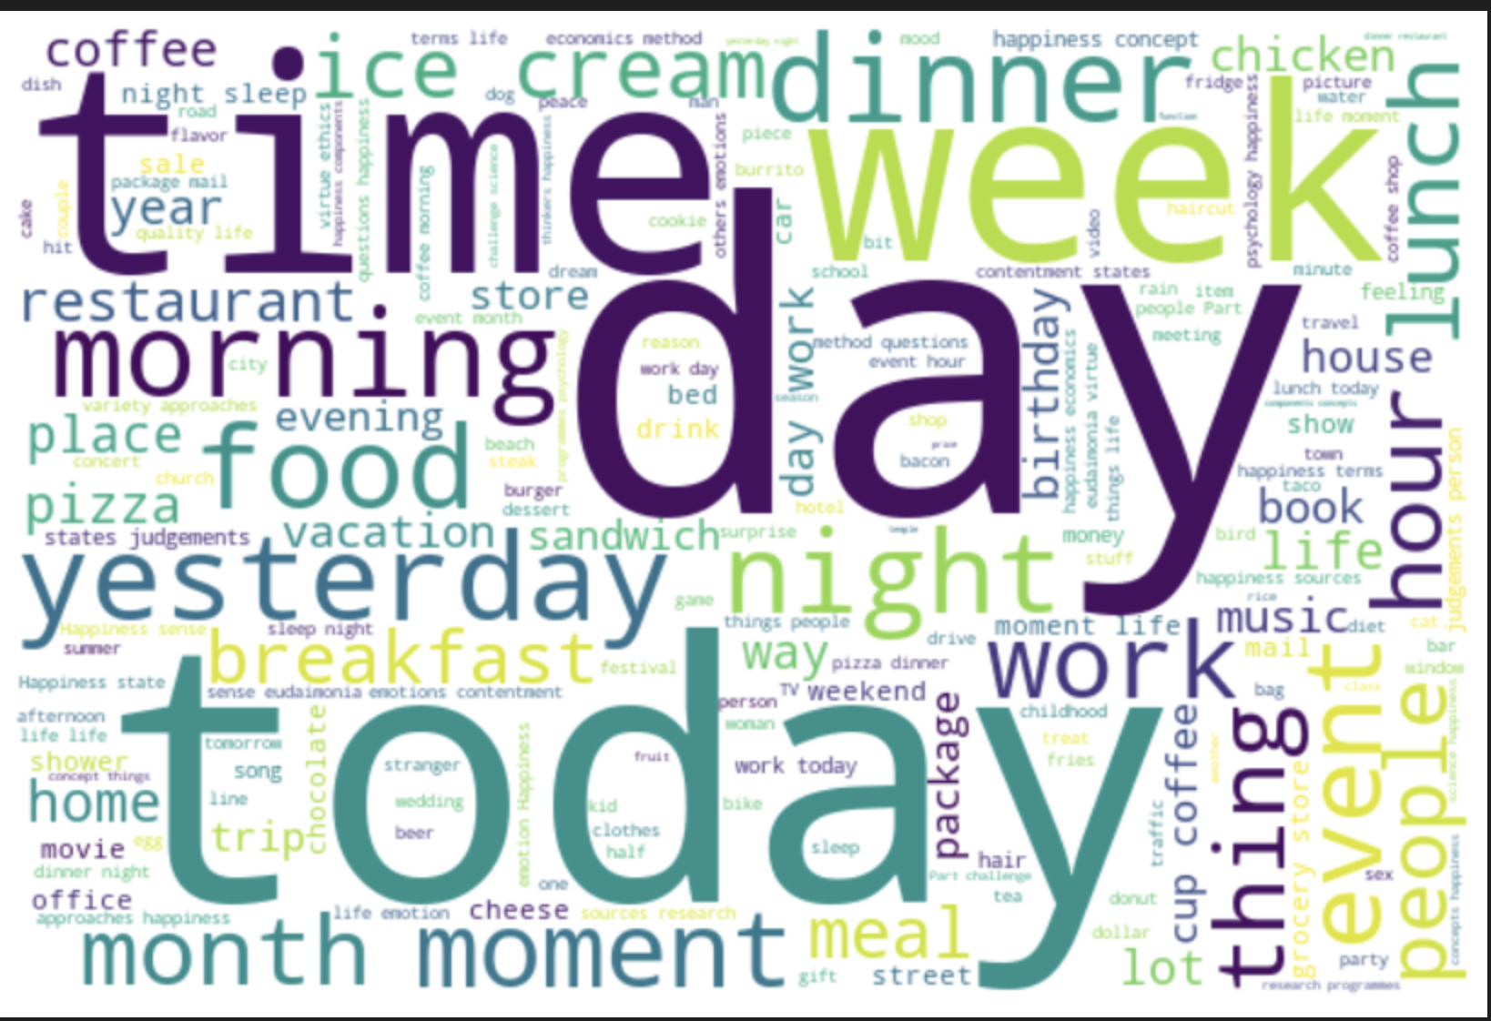
3 + 1 Questions
3 Questions in each sub-category
- Enjoy the moment:
When I enjoy the moment, my happiness is from myself or from others?
* Activity – Noun

Slide 3
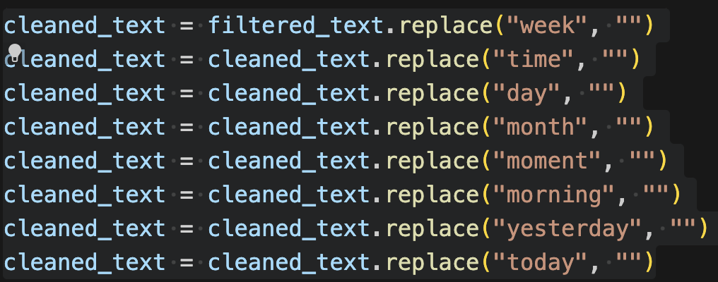
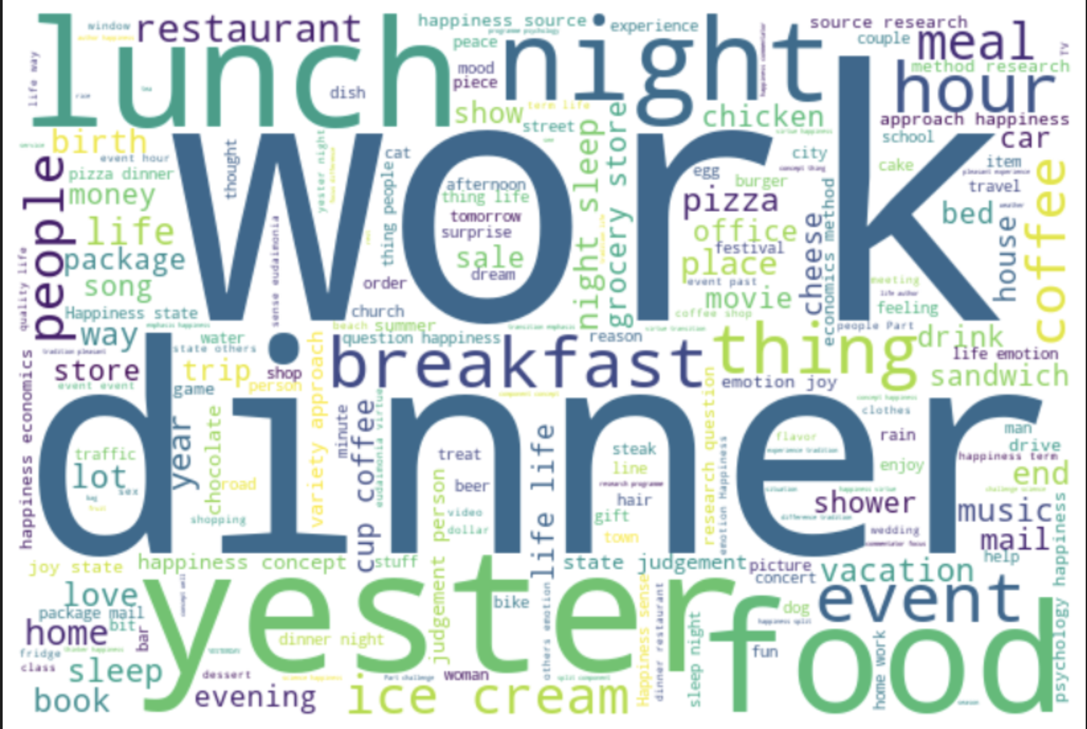
3 + 1 Questions
3 Questions in each sub-category
- Enjoy the moment:
When I enjoy the moment, my happiness is from myself or from others?
* Only keep Activity – Noun words
* Remove unrelated words

Slide 4

3 + 1 Questions
3 Questions in each sub-category
- Exercise:
Which sports makes people happy more frequently?
* Only keep sport – BOTH Noun AND Verb
* Remove unrelated words

Slide 5
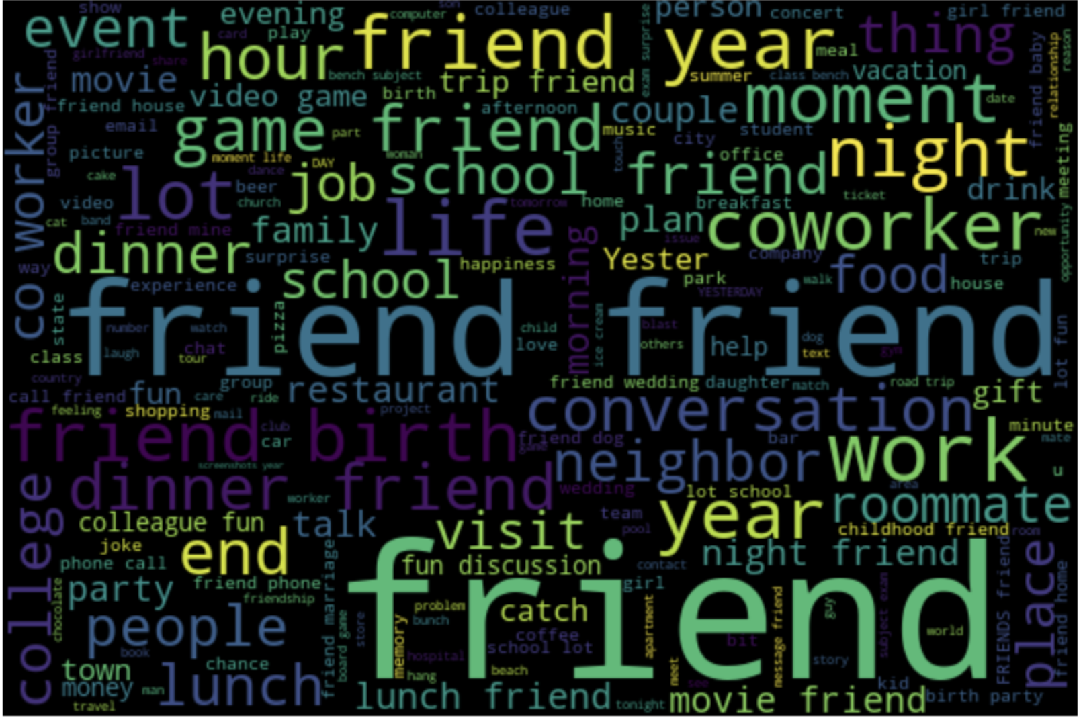
3 + 1 Questions
3 Questions in each sub-category
- Bonding:
In happy moment with bonding type, who are we bond with and what activities we did make us happy?
* Keep WHO and activities – Noun Word
* Remove unrelated words

Slide 6
3 + 1 Questions
1 Additional Question
- Build ML classification model
- Find the high-related words in each category and find corresponding answer for previous 3 Qs using this model
- Predict the category of future sentences using this model

Slide 7
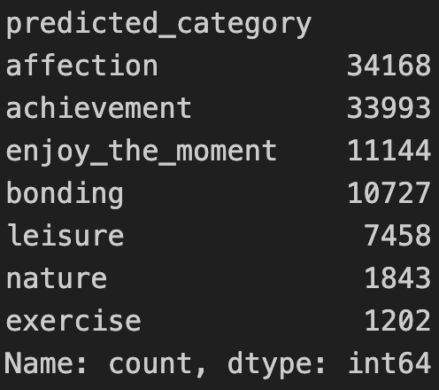
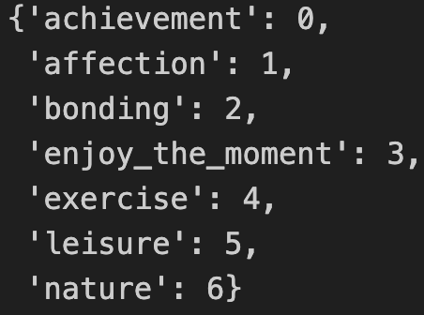
3 + 1 Questions
- Procedure:
Read data, get the classification group and number
Label Encode the target

Slide 8
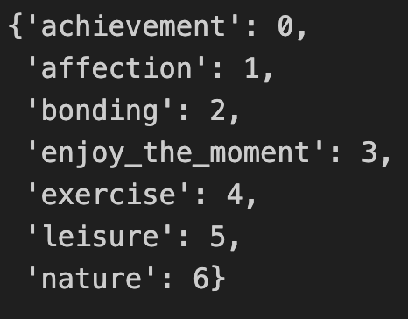
3 + 1 Questions
- Procedure:
Preprocess the feature
- Remove stopwords in each sentence
- Lemmatization for each sentence (e.g Caring – Care)
Label Encode the target
Train-test split
TF-IDF to process the feature

Slide 9
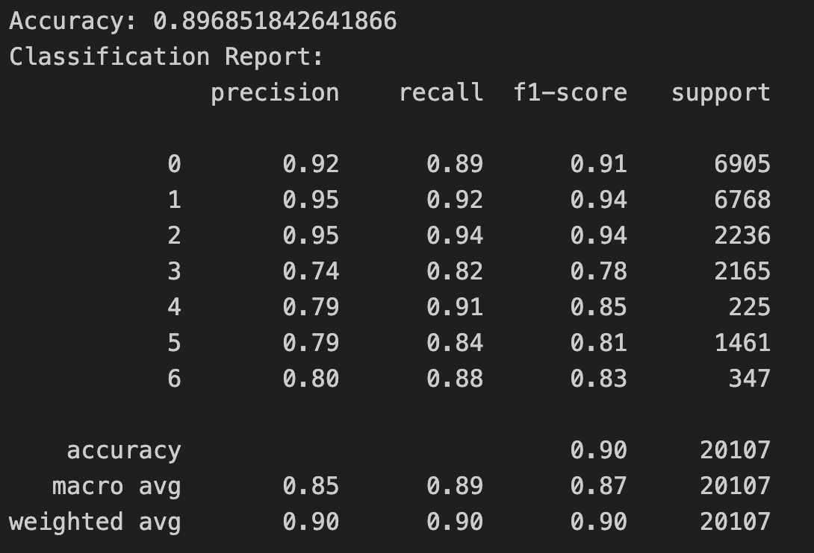
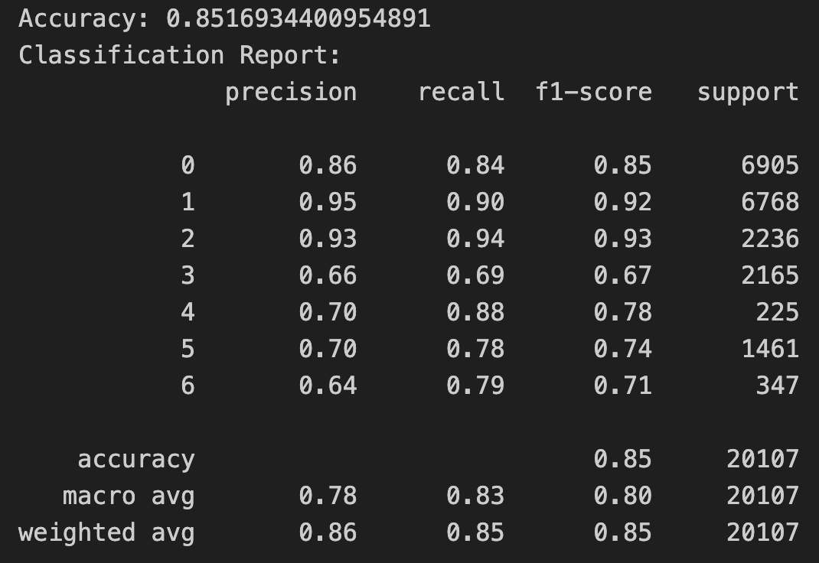
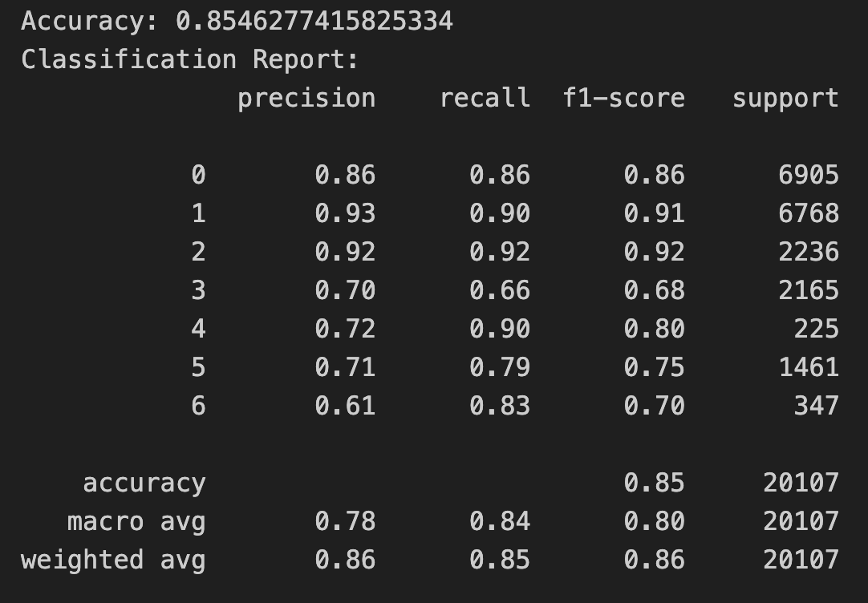
3 + 1 Questions
Logistic
RF
7. Use SMOTE to solve the imbalanced problem for training group
8. Fit the baseline model (logistics) and comparison models (XGBoost and Random Forest) then compare them
9. GridSearch the best Parameter (optional)
XGBoost

Slide 10
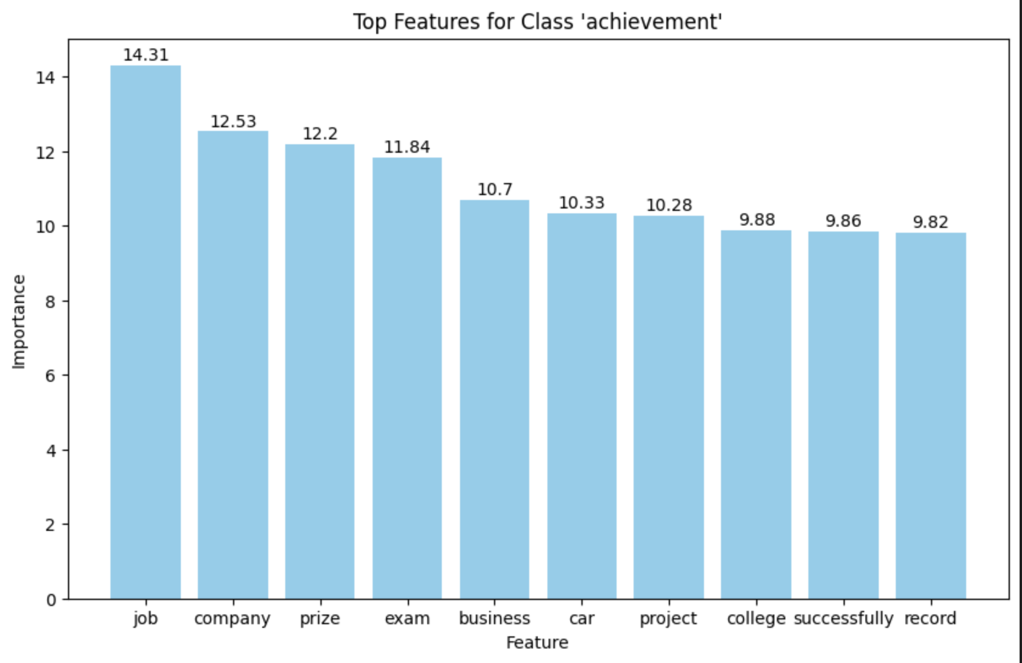
3 + 1 Questions – Visualize the result

